Slide 1



WIND TURBINE BLADE MANUFACTURING
Name : Mandar Bapat
Roll No. : 190475
Section : S-8
Tutor : Dr. Shobhit Omar
Instructor : Dr. Anish Upadhyaya

Slide 2
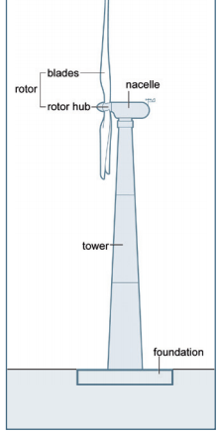
Introduction
Manufacturing of wind turbines grew as the need for alternative sources of energy rose. Today , we have wind farms stretching hundreds of acres of land.
A wind turbine consists of 3 main parts:
The tower
The nacelle and
The rotor
The tower supports the nacelle and the rotor is fitted in the nacelle. The rotor consists for the blades which rotate and generate electricity.

Slide 3
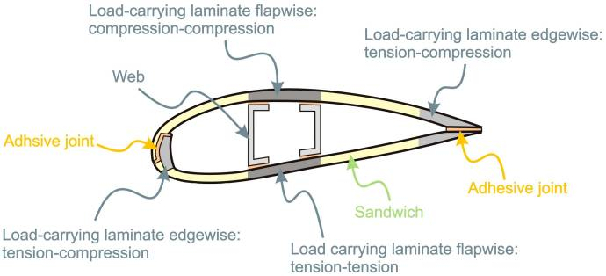
BLADE DESIGN
The Outer structure provides aerodynamic shape while the Internal supports like webs provide the necessary support. Sometimes , integral stiffeners are used instead of webs.
The 2 outer shells are joined with an adhesive. The outer shells are ‘sandwich’ structured , with foam between 2 laminates.

Slide 4
LITERATURE REVIEW
The world is moving towards renewable sources of energy. This has led to the expansion of the wind turbine industry. Wind energy is said to be the most ‘green’ renewable source of energy compared to hydro , solar and biomass.
This term paper presentation describes how the wind turbine blades are made , the materials required and the manufacturing processes. The requirement of a particular aerodynamic design and the ability to sustain extreme load and fatigue cycles requires the use of composite materials , specifically Fiber Reinforced Polymers
The presentation describes the contemporary type of fiber and matrix used as well as the manufacturing process. Later , the presentation also introduces new nano-reinforcement techniques and fibers like CNT and CNF. The presentation ends with a description of how processing parameters can change the mechanical properties of the composites.

Slide 5
APPLICATION AND DESIGN
Wind turbine blades look simple but are complex in nature. The main points that are kept in mind are (i)The aerodynamic design , (ii) Incorporation of the suitable materials .
The main motive of the wind turbine is to extract the kinetic energy of the wind. The exact formula relating power generated and other variables is :
$$P=\frac{1}{2}ρAv3Cp$$
where P = power generated , $ρ$ = Air density , A = area swept by the blades
v = wind velocity and $Cp$ = Betz coefficient .
Since we want to increase our energy output , we naturally look for factors that affect the power generated.

Slide 6

There are several factors that affect the efficiency of power generation and hence are deciding factors in blade design :
Propulsion method : There are basically 2 different propulsion mechanisms : drag and lift. Wind turbines nowadays rely on the lift force rather than the drag force. This is particularly because the relative wind velocity decreases as rotor speed increases thereby decreasing the efficiency. The maximum theoretical efficiency of the lift mechanism is much higher than that of the drag mechanism.
Tip – speed ratio : Defined as the ratio of the rotor blade velocity to the relative wind velocity. Normally higher tip speeds are preferred. But high tip speeds require thin blades. Although thin blades can reduce the manufacturer’s production costs , the increased forces due to high tip speeds pose a problem to the strength of the blade.
Chord length and quantity of blades : The blade design also relies on the chord length. Optimal chord length is calculated using the Betz optimization , although this method of calculating the optimal chord length does not work for low tip speeds. Also it has been observed that 3 blades provide optimum performance environmentally , economically and commercially.

Slide 7
4.Lift to Drag ratio : The main objective is to increase the lift force and reduce the drag force. Hence a higher lift to drag ratio is always preferred.
Apart from the above effects , the blades must be strong enough to tolerate different kinds of loads :
Aerodynamic load : The lift and the drag forces exert a certain load on the turbine blades. The net force can be thought of as a combination of a Thrust force and Reaction force. Thrust force acts in the direction of rotation , while the Reaction force is normal to the blades. These aerodynamic loads lead to Flapwise and Edgewise deflections .
Gravitational and Centrifugal loads : Rotating bodies experience a radially outward directing pseudo force called Centrifugal force. They increase roughly cubically with turbine diameter.
To summarize , we need blades that are :
Strong – So as to withstand the loads and fatigues
Lightweight – So as to reduce the production and set up costs and decrease the gravitational load
Stiff – So that they don’t behave erratically in situations of high wind or load

Slide 8
Materials used
The materials need to be selected carefully keeping in mind the above requirements. The material , hence , must have high fatigue strength , be lightweight , must be stiff , be cost effective as well as environment friendly.
Historically , wind turbine blades were made of steel. Charles F. Brush made the first automatically operated wind turbine with blades made from steel. But the wind turbine blades failed after a few hours of operation. The Gedser Wind turbine used blades made from composite materials and was quite successful. This demonstrated the usefulness of composite materials in blade manufacturing. In modern times , the blades are mostly made from composite materials.
When we look at the Ashby plots, we find that composites are the most suitable materials.
Most of the composite materials are Fiber-Reinforced Polymers. Naturally , the focus is to choose the optimal pair of fiber and matrix. Fiber is a filament of reinforcing material that generally has a circular cross-section. Matrix is the polymer phase in which the fibers are impregnated.

Slide 9

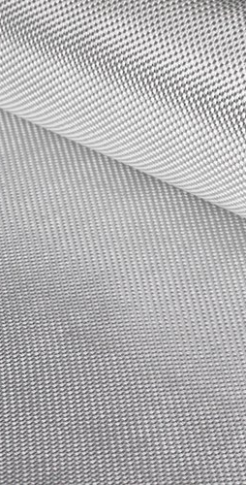
GLASS AND CARBON FIBERS
Mostly E-glass fibers (also called electric glass or borosilicate glass) are used.
A more advanced S-glass fibers(‘s’ for ‘Strength’) have 40% higher tensile and flexural strengths, and 10–20% higher compressive strength and flexural modulus, as compared to E-glass , but they are expensive too.(Shown beside)
R-glass fibers are made up from calcium aluminosilicate glass with relatively low silica content.
Some other advanced fibers developed include ECRGLAS , Advantex and WindStrandTM.
Carbon fibers show much more stiffness and lower density , favorable for thin blades , but has low damage tolerance , ultimate strain and compressive strength.

Slide 10
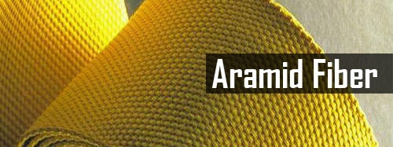
Aramid and basalt fibers
Aramid stands for aromatic polyamide. These have high mechanical strength , are tough and damage tolerant.
But aramid polymers have other disadvantages. They absorb moisture , have low compression strength and low adhesion to the polymer matrix. They also degrade due to ultraviolet radiation.
Basalt fibers are relatively new and have only been experimented on small turbines, but they also show good mechanical properties. They are stronger , stiffer and lighter than E-glass.

Slide 11
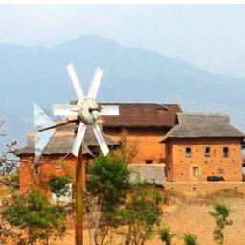
Hybrid composites and natural fibers
A good way to mitigate the disadvantages of different types of fibers is to use a hybrid composition like E-glass/carbon or E-glass/aramid etc. In fact , the world’s longest wind turbine rotor blade is made of carbon/glass hybrid fibers.
Incorporation of glass fibers in carbon fibers showed a significant improvement in the impact and tensile properties.
Natural fibers have proven to be better than the synthetic composites in certain situations. Common examples include flex , jute , hemp etc. Certain types of timber are also suitable in making small scale wind turbines(shown on left).
Although natural fibers are environment friendly and have more strength and stiffness in certain conditions , they absorb a lot of moisture and have low thermal stability.

Slide 12
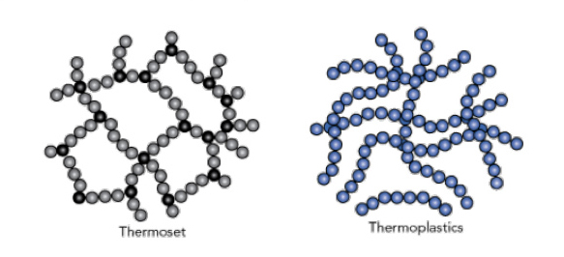
THERMOSETS AS MATRIX PHASE
THERMOPLASTICS AS MATRIX PHASE
Most of the reinforced polymers use thermosets as their matrix phase. Their low viscosity make them favorable for the infusion process to create blades and hence allow higher production rates. Also , they can be cured at low temperatures , which in turn reduces energy requirements. Epoxy resins are more commonly used instead of polyesters.
Properties such as high fracture toughness , larger elongation at fracture and recyclability make thermoplastics a good option instead of Thermosets. But their high viscosity(around 10²-10³ Pa compared to 0.1-10 Pa for Thermosets) and higher processing temperatures can affect production rates , damage fiber properties and make production of large , thick plates difficult.

Slide 13
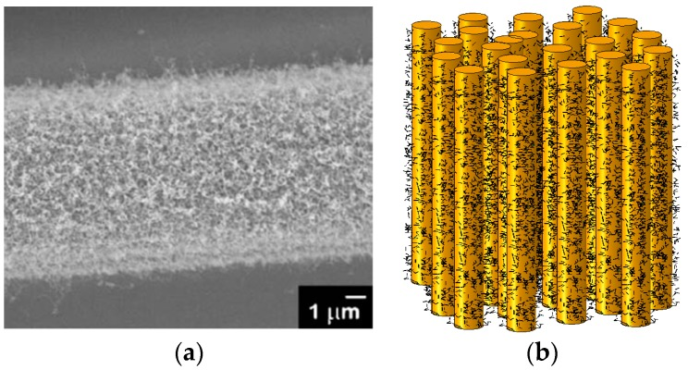
NANOENGINEERED POLYMERS AND COMPOSITES
The recent research is based on enhancing the properties of the composites by nano reinforcement in the matrix phase.
An increase in about 30-80% is observed in fracture toughness , fatigue resistance and shear strength by adding only small amounts of nano reinforcement like Carbon Nanotubes(CNT) or Carbon Nanofibers(CNF).It has been shown that addition of small amount of CNT can increase the lifespan of the blades by 1500%.
Common nano reinforcements are CNT , CNF , Graphene etc.
– Micrograph of a carbon fiber with CNT reinforcement
- Computational model with CNT particles

Slide 14

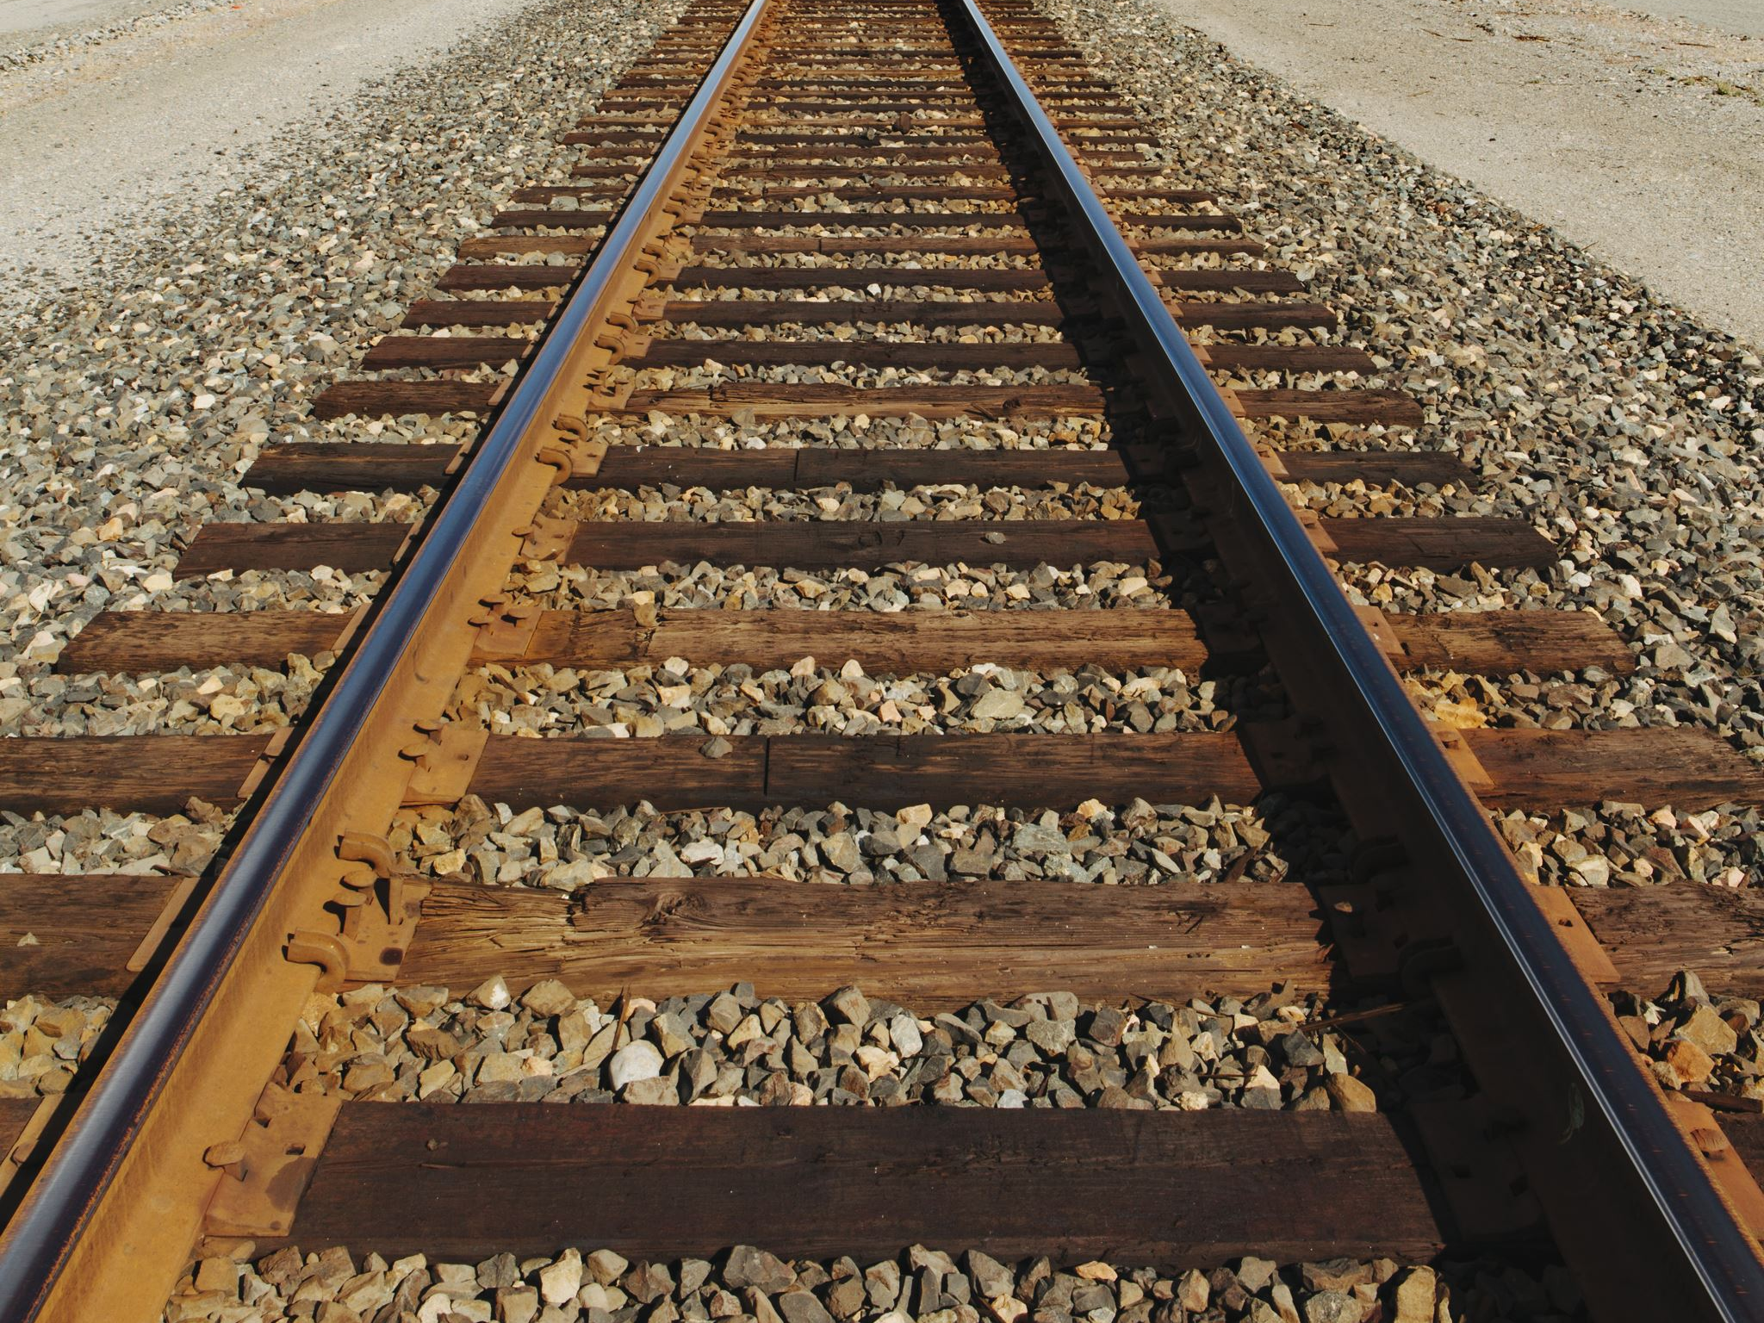
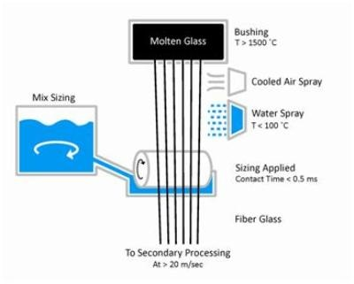
MANUFACTORING PROCESSES INVOLVED
A multitude of processes are involved in the manufacturing of the wind turbine blades. Since , they are mainly produced of fiber reinforced polymers , the processes described here are for the production of these composites. In addition , a variety of other processes are also involved such as :-
Sizing : Size is a surface coating on the fibers , which consists mainly of organic compounds. Sizing is precisely the name of the process. This is done mainly as a protection to the fibers as well as to ensure good bonding with the matrix phase.

Slide 15

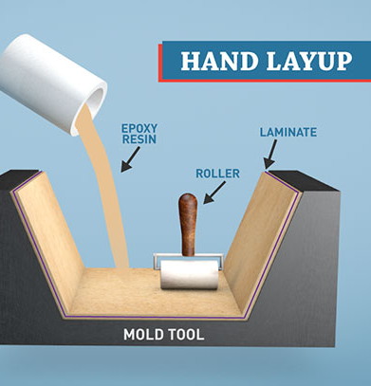
Wet HAND LAY UP PROCESS (Laminating technique)
The fiber in the form of mats or unidirectional tapes is first laid into an open mold. It can be laid in multiple or single layers.
These layers were then impregnated with resins using rollers and brushes. Curing was normally done at room temperatures. Higher temperatures were required for certain matrix phases like epoxy.
Ideal for small-medium turbine blades.
Although this process provides flexibility in material design and fiber arrangement , it is highly labor intensive , time consuming and defect prone.

Slide 16
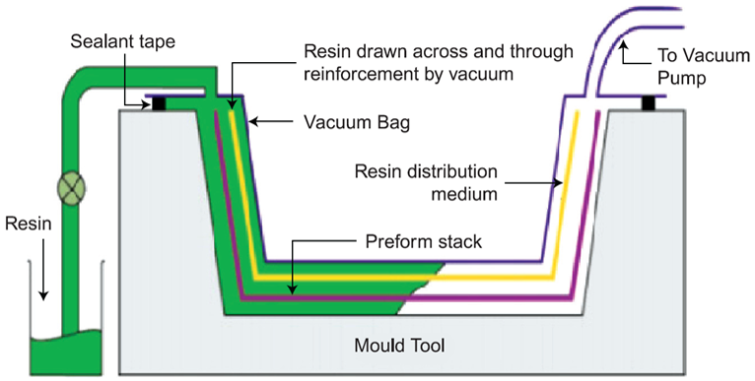
Resin infusion
Most widely used for production of wind turbine blades.
The fibers are first placed in a closed , sealed mold which is encapsulated with a vacuum bag. Once the vacuum is created , the resin is injected into the mold cavity.
After the resin wets the fibers and fills the empty spaces , it is cured with heat. It can be at the room temperature or at a slightly higher one.
There are 2 variants to the process :
Resin Transfer Molding(RTM) : The resin is injected at a pressure greater than the atmospheric pressure.
Vacuum Assisted RTM : The resin is injected at pressures lower than that of atmospheric pressure. This variant is widely used.
The process allows for production of longer blades , results in good quality and can be automated. But it is relatively complex and requires low viscosity resins.

Slide 17

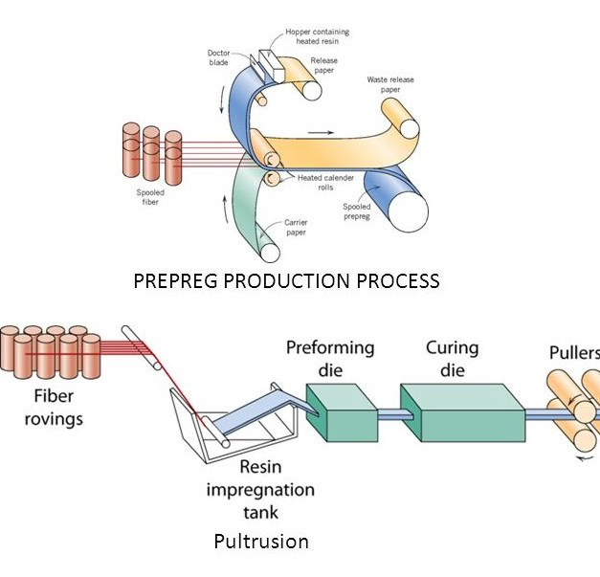
Prepreg method
This method is based on using ‘pre-impregnated’ fibers that already have a certain amount of resin between them .
The layers of prepregs are laid onto the mold and then covered with a vacuum bag , much like the resin infusion process. These are then heated.
The heat cures any uncured resin and helps in bonding between the different layers.
The main advantages of this process are the high level of automation that can be achieved , less defects , more choice of resins and the production of large blades in one go.

Slide 18
Prepreg method
The beginning stages of producing pre-impregnated materials are crucial to developing an application-specific composite. The application of the finalized composite should be analyzed in order to know which fibers and resins will provide superior properties.
One of the most advantageous aspects of replacing inefficient materials with prepregs is that the manufacturing process produces far less waste. The resin impregnation process precisely controls the fiber-to-resin ratio as well as ply thickness. After the fabric has been injected with the resin, excess materials are removed from the structure. During this time, the reinforcement undergoes partial curing, which is known as the B-Stage.
Another added benefit of developing prepreg reinforcements is that these structures require less time for curing. As the B-stage of the process initiates, prepregs require refrigerated storage in order to cure. After a short period in refrigerated storage, the curing process is then activated by applying heat and pressure from heating tools such as an autoclave. Thermoset and thermoplastic prepregs create durable, lightweight composite structures suitable for an array of applications.

Slide 19
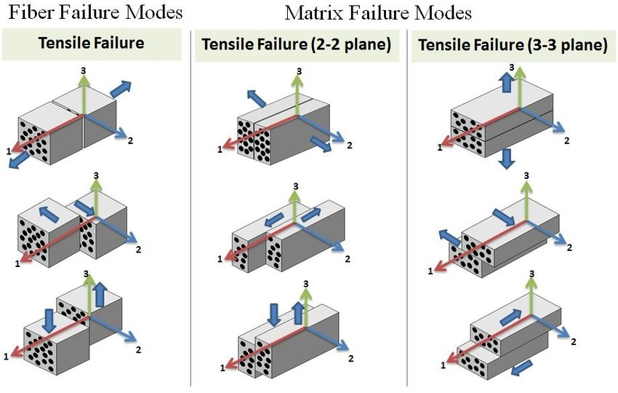
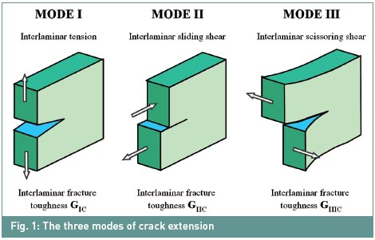
Certain Defects

Slide 20
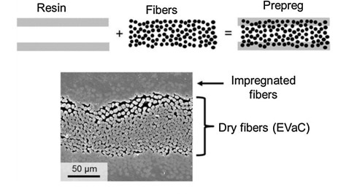

Slide 21
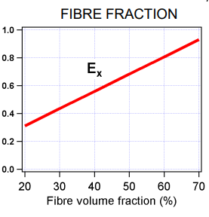
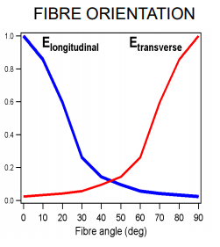
EFFECT OF PROCESSING PARAMETERS ON PROPERTIES
The graph alongside shows how different matrix phases and the time for curing affect the properties of the composites.
Even the angle at which fibers are laid or the fiber content can change the mechanical properties of composites.

Slide 22
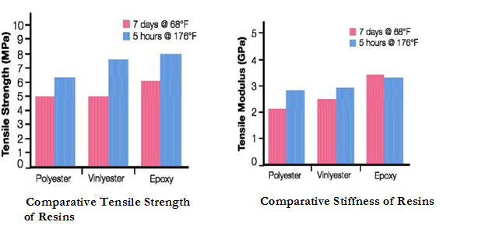

Slide 23

References
Leon Mishnaevsky et.al , Materials for Wind Turbine Blades: An Overview , Materials(Basel) , v.10(11) , 11 pages , 2017 ,
https://www.ncbi.nlm.nih.gov/pmc/articles/PMC5706232/
2. Gemma Hutton , racecar engineering ,
https://www.racecar-engineering.com/tech-explained/how-are-composites-used-in-motorsport

